Slide 1


SAP S/4HANA Training
MASTER DATA GOVERNANCE (SAP MDG)
Neeraj Gupta
Session 21
SAP MDG – APIs

Slide 2
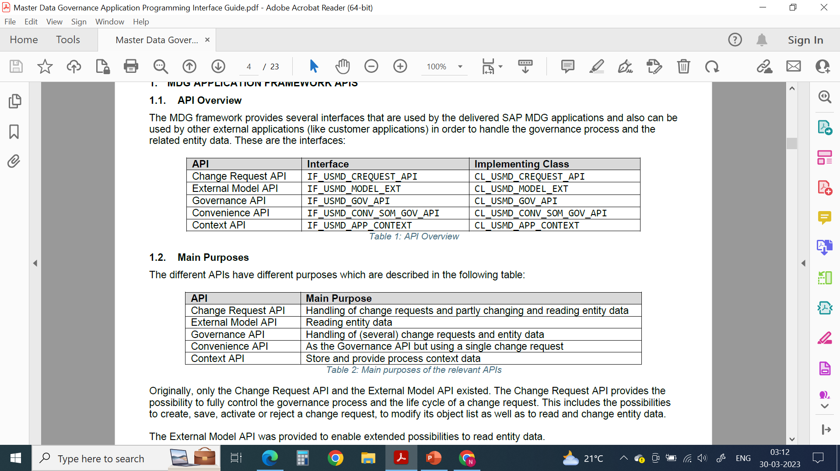
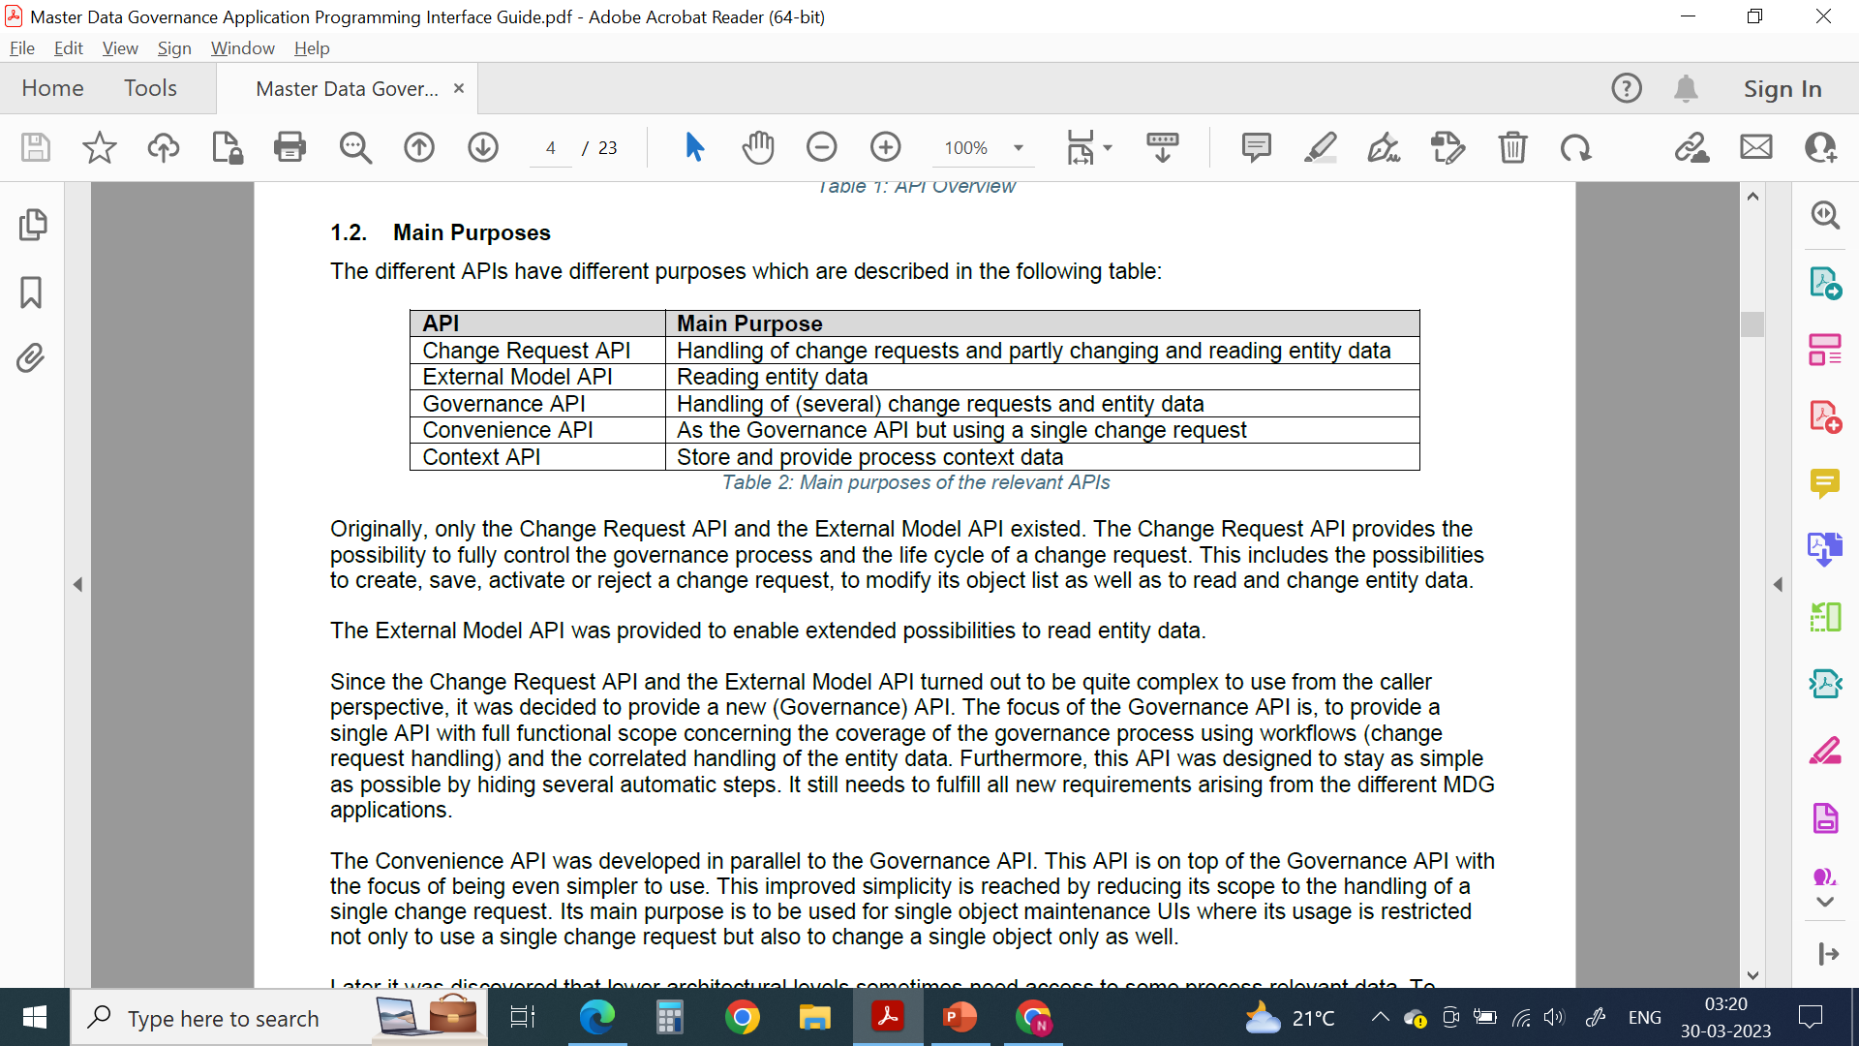
Integration Scenario: MDG APIs and Purpose
21
SAP MDG – APIs
Different APIs and their functional scope depends on the MDG release
Scope of the External Model API is restricted to read data and it does not provide any possibility to change data
The Convenience API fills the Context API as completely as possible

Slide 3
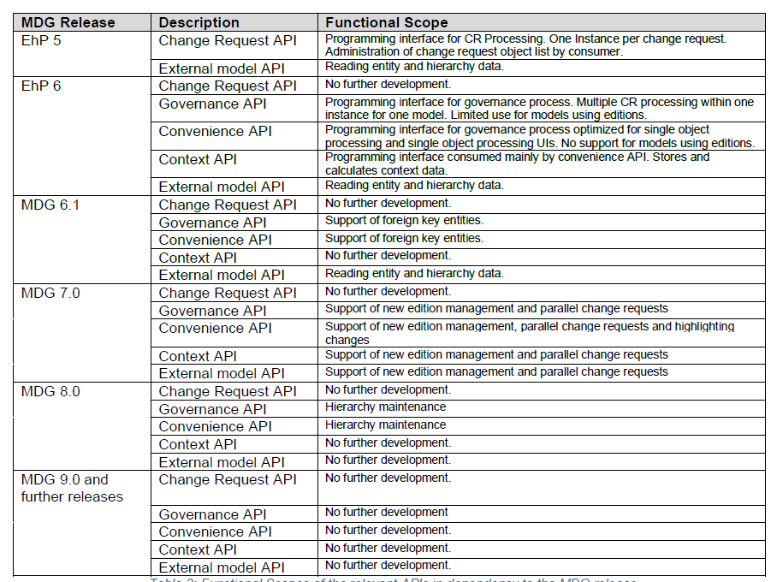
Integration Scenario: Functional scope
21
SAP MDG – APIs

Slide 4
Integration: Architecture
21
SAP MDG – APIs

Slide 5
Integration Scenario: MDG APIs and Functional scope
21
SAP MDG – APIs
One API instance can only handle one dedicated data model.
It is not allowed, to use two of Convenience API, the Governance API and the Change Request APIs within the same LUW.
External Model API and the Context API are independent on the other APIs and can always be used in parallel to all other ones
The Convenience API, the Governance API and the Change Request API are designed to be called from external applications (such as UI layers and services). It is not allowed to call these interfaces from architecturally deeper layers like access classes or any BADI implementations
External Model API and the Context API have no caller restrictions and especially for the External Model API the calls from access classes and BADI implementations belong to the most important use cases.
Exception: External Model API may not be called out of the READ methods of access classes

Slide 6
Integration Scenario: MDG APIs and Functional scope
21
SAP MDG – APIs
NOT to use the IF_USMD_MODEL at all with API calls
Use of MDG APIs in BADIs may be restricted for a given MDG release and is dependent on the completeness of configuration of activated data models, workflows settings and change request types.
External Model API can be instantiated directly using the static method GET_INSTANCE of the class CL_USMD_MODEL_EXT or it is given in some other interfaces. Relevant Interfaces: IF_USMD_MODEL_EXT, IF_USMD_MODEL_CR_EXT
The data model is mandatory for the API
Context API interface IF_USMD_APP_CONTEXT, method GET_CONTEXT - Used data model, current used process and current change request meta data

Slide 7
Governance APIs
21
SAP MDG – APIs
Static factory method, GET_INSTANCE, to provide an instance of the requested API for a specific data model.
Governance API CL_USMD_GOV_API (IF_USMD_GOV_API)
GET_INSTANCE allows applications to inherit from this class and provide an own implementation, which can provide additional methods for your convenience (for example, providing a method to read a business partner with the structure BUT000 instead of reading the entity type BP_HEADER
Governance API is consumed by the convenience API and the data load process

Slide 8
Interfaces of the Governance APIs
21
SAP MDG – APIs
Interface IF_USMD_GOV_API combines all necessary sub-interfaces to support the governance process
Sub- interfaces:
F_USMD_GOV_API_CR_DATA – CR header data, CR notes, change request attachments, and target systems
IF_USMD_GOV_API_ENTITY - data manipulation based on the governance process
F_USMD_GOV_API_PROCESS - check the data of a change request and to create and forward the workflow
F_USMD_GOV_API_SERVICES - retrieve change requests by a specific entity as well as for step type determination
F_USMD_GOV_API_TRANS - save the change requests and the corresponding inactive entity data, and to refresh the master data governance buffer
IF_USMD_GOV_API_CR_ACTION - deletion of a change request in draft mode

Slide 9
Convenience API
21
SAP MDG – APIs
Static factory method, GET_INSTANCE
CL_USMD_CONV_SOM_GOV_API (IF_USMD_CONV_SOM_GOV_API)
Designed for consumption of the governance process within a specific object application
Has a specific SET_ENVIRONMENT method - If you want to create a new change request, the change request type has to be defined

Slide 10
Convenience API
21
SAP MDG – APIs
Sub Interfaces
IF_USMD_CONV_SOM_GOV_CR - Change request header data as well as change request notes, attachments, and target systems.
IF_USMD_CONV_SOM_GOV_ENTITY - Handle entity data. Entity data can be enqueued
IF_USMD_CONV_SOM_GOV_TRANS - Relevant to transactional handling
IF_USMD_CONV_SOM_GOV_CR_ACTION - Deletion of a change request in draft mode

Slide 11
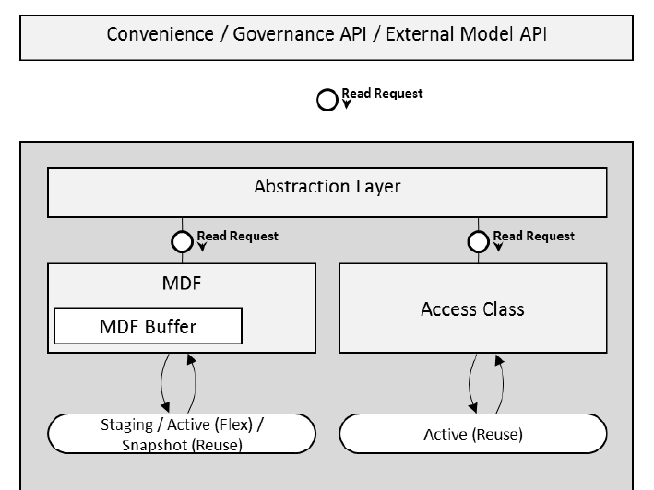
Reading Entity Data Entity data can be read using the Convenience API, the Governance API, and the External Model API
21
SAP MDG – APIs

Slide 12
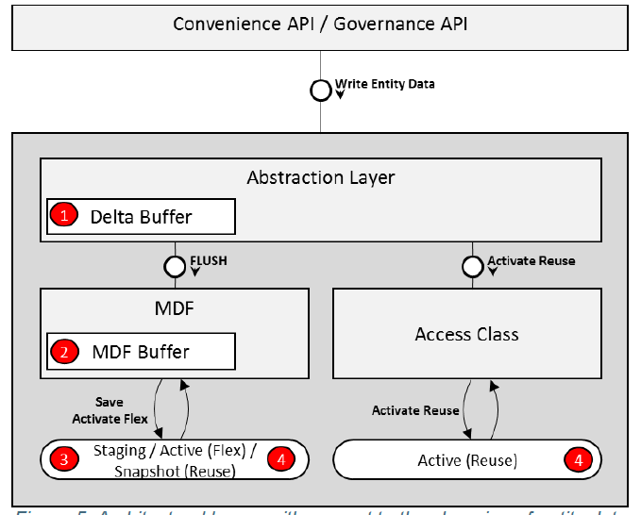
Changing Entity Data
21
SAP MDG – APIs
Entity data can be changed by writing processes or by derivations. Entity data can be written by the Change Request API, the Governance API or the Convenience API
Abstraction layer offers different write modes
Direct Mode
Direct Mode with Derivations
Collect Mode

Slide 13
Supported Derivations during Data Write
21
SAP MDG – APIs
Entity data can be changed by writing processes or by derivations. Entity data can be written by the Change Request API, the Governance API or the Convenience API
Standard Derivations:
BADI implementations of the BADI USMD_RULE_SERVICE in the method DERIVE_ENTITY of the BADI interface IF_EX_USMD_RULE_SERVICE
Using BRF+
Derivations in Access Classes:
Access class interface IF_USMD_PP_ACCESS provides the method DERIVE_DATA
method is called per involved access class during a flush and gets the current content of the Delta Buffer to find out which data changes had been collected since the last flush was process
Cross entity derivations:
BADI USMD_RULE_SERVICE in the method DERIVE of the BADI interface IF_EX_USMD_RULE_SERVICE2

Slide 14
Authorization in MDG APIs
21
SAP MDG – APIs
Entity Authorization
Reading and writing entity data to a change request >> an authority check is performed
Display authorization (AUTH_ACT = 3)
Authorization to create the entity (AUTH_ACT = 1) - Inactive data
Authorized to change the entity (AUTH_ACT = 2) – Active data
Change Request Authorization
Create CR (AUTH_ACT = 1) – during creation of CR
Create a workflow >> the CREATE authorization (AUTH_ACT = 1)
Complete a workflow step >> the CHANGE authorization(AUTH_ACT = 2)

Slide 15
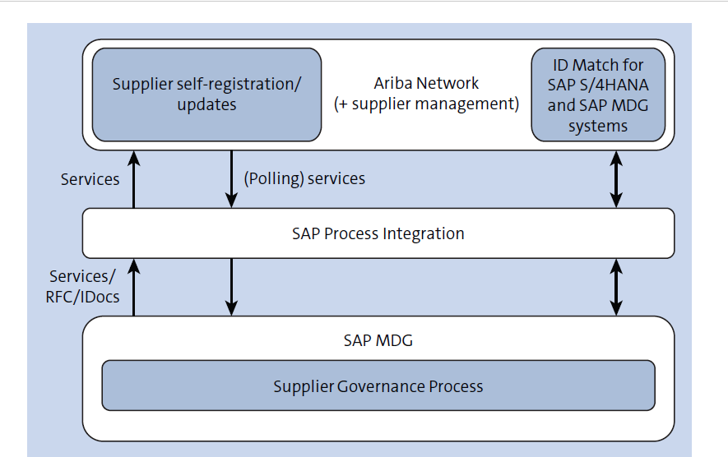
Integration Scenario: SAP Ariba with SAP MDG
21
SAP MDG – APIs

Slide 16

End of Session21

Slide 17

Questions

Slide 18

Neeraj gupta

Slide 19


We’re committed to empower you to be
Most Desirable Resource
through powerful training solutions.
We build the workforce of the future.
250+
Corporate Clients
30,000+
Learners Trained
25000+
Learners Placed
FREE WEBINARS
Sign up for free webinars with industry experts every fortnight!
Enroll Now!
Contact us today!
https://anubhavtrainings.com/

Slide 20




More from AnubhavTrainings.com

